Slide 1

G.L.O.B.E
UNIVERSITY AT SEA
Aayush Sharma
David Chan
Fiona Tan
UTS2116

Slide 2
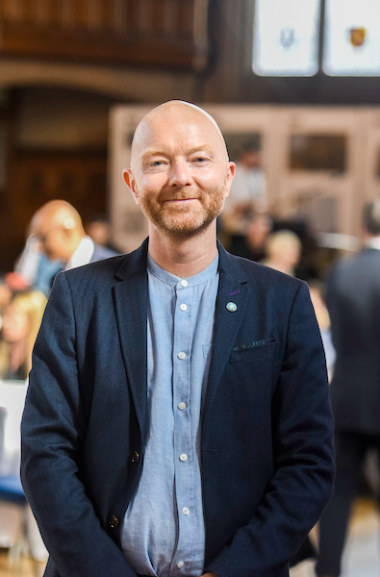
“If we’re going to measure what universities do, let’s concentrate on what really counts” (Skyrme, 2021)
G.L.O.B.E

Slide 3
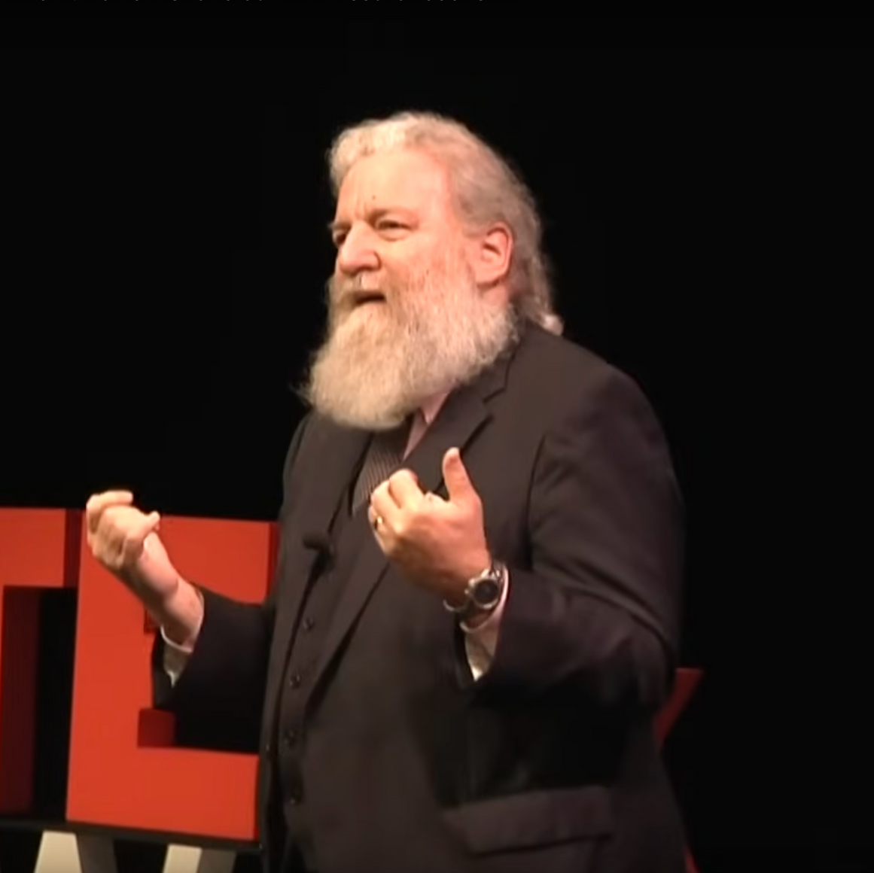
“...the complex problems...are not going to be solved from a disciplinary perspective.” (Helfstand, 2019)
G.L.O.B.E

Slide 4
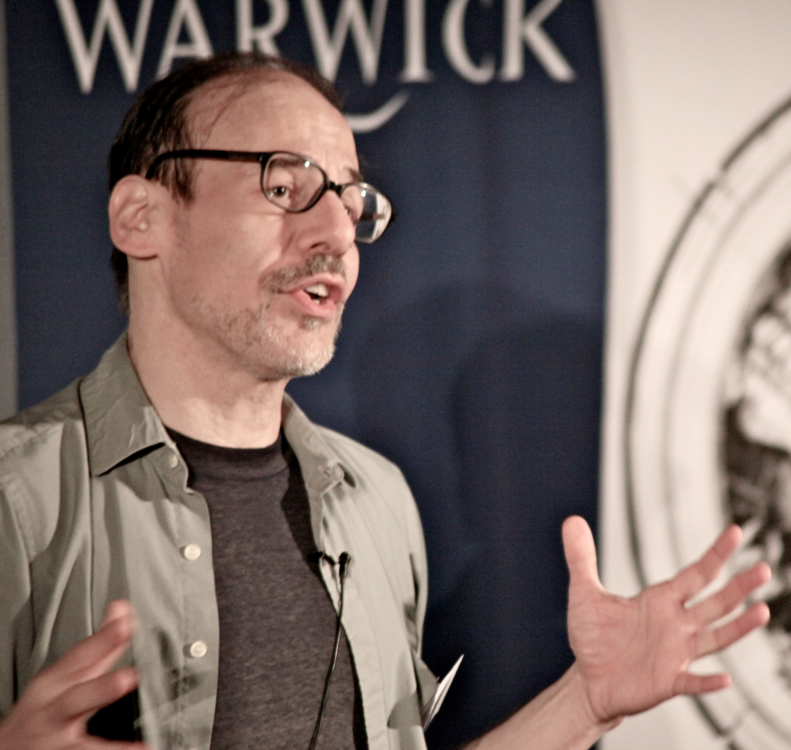
“...deviant interdisciplinarity aims to recover some lost unity of knowledge...” (Fuller, 2023)
G.L.O.B.E

Slide 5



THE GAP
Deviant-Interdisciplinary knowledge
Global challenges
G.L.O.B.E
Notes:
Thus there is a need for a university that cultivates deviant-interdisciplinary knowledge to aid in the tackling of the global challenges

Slide 6
Global
Learning
Opportunities for
Balanced
Education
G
LOB
E
G.L.O.B.E

Slide 7
OUR VISION
To produce graduates capable of driving solutions for global problems by fostering a multidisciplinary understanding of the world, with a strong emphasis on sustainability, community engagement, and economic resilience
G.L.O.B.E

Slide 8
OUR MISSION GOALS
Promote Deviant Interdisciplinary Learning
Develop Critical Thinking and Problem-Solving Skills
Align education with SDGs
G.L.O.B.E

Slide 9
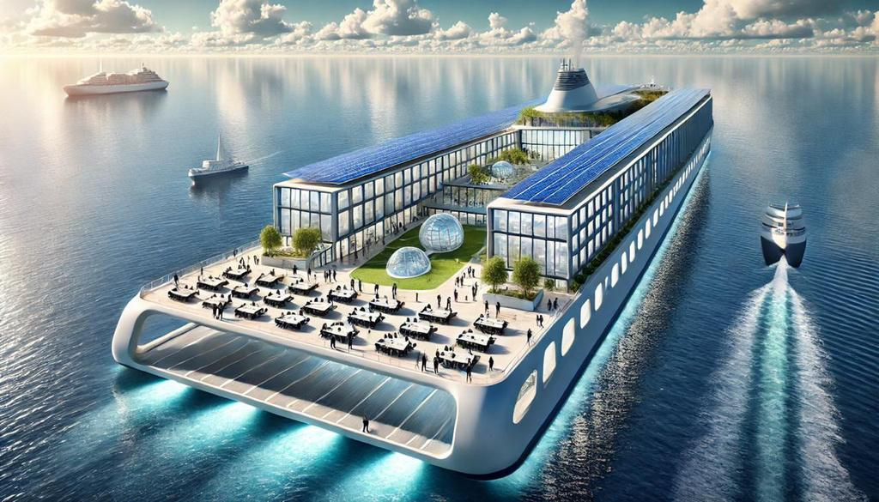
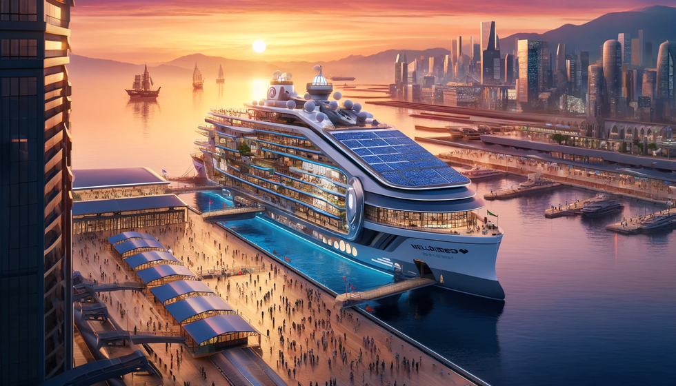
MOBILE CAMPUS
Cultural Immersion
By travelling to various regions, students can participate in local projects, interact with different communities, and develop a nuanced understanding of global issues.
Location-based Interdisciplinary Learning
Courses and projects are designed to coincide with each location, where students can engage in fieldwork, community interaction, and specialised research directly related to the areas they visit.
G.L.O.B.E

Slide 10
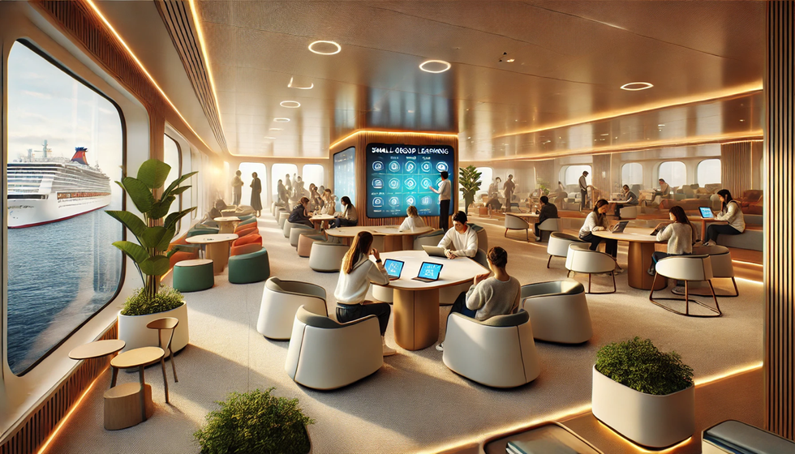
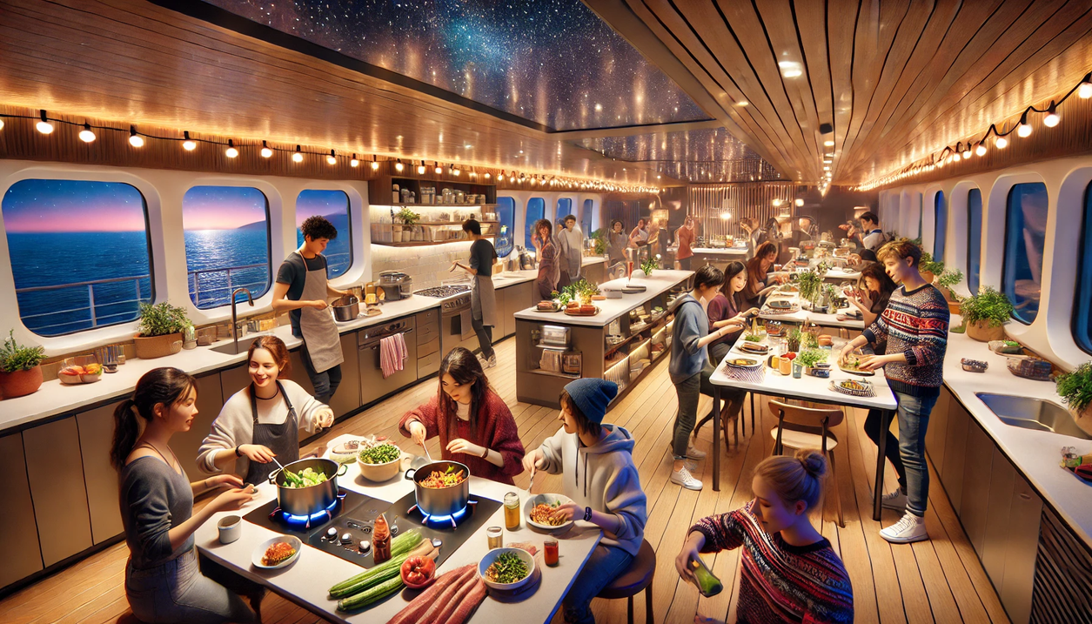
COMMUNITY SPACES
Collaborative Learning Hub
The ship is designed with multi-use spaces for small-group learning, discussions, and workshops, encouraging cross-disciplinary interaction and fostering a community of engaged learners.
Adaptable Living-Learning Environment
Living on a mobile campus cultivates resilience and adaptability, as students learn to adjust to new settings and collaborate in close-knit, interdisciplinary groups.
G.L.O.B.E

Slide 11
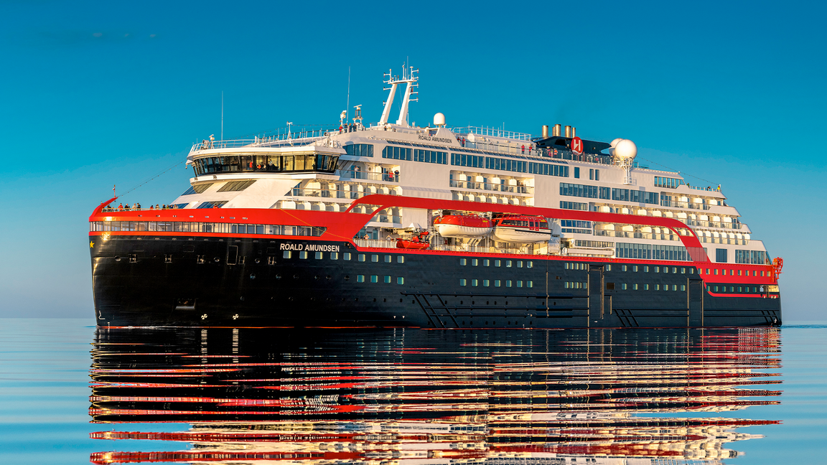
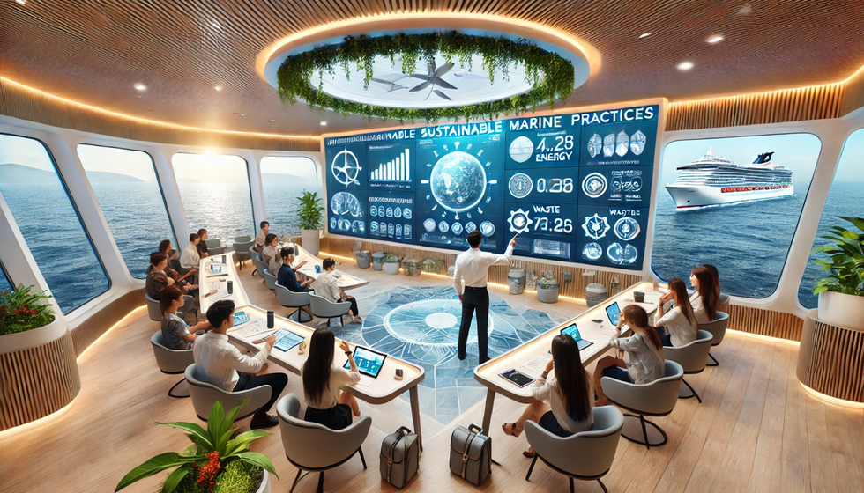
SUSTAINABILITY IN PRACTICE
Inspired by the MS Roald Amundsen
Adopts a hybrid approach, combining batteries, solar panels, and alternative fuels like LNG or biofuels to optimise energy use and reduce emissions
Sustainability in-action
The ship itself becomes a learning tool, with programs on sustainable maritime practices, ocean health, and resource management that allow students to see sustainability principles in practice daily.
G.L.O.B.E

Slide 12
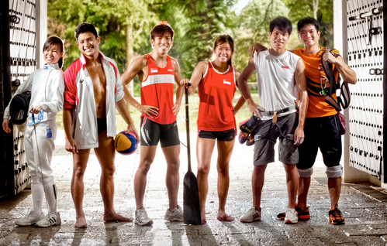



ADMISSIONS
Holistic
Scenario-based
Diverse
Needs-blind
Evaluation
Assessment
Backgrounds
Admissions
G.L.O.B.E

Slide 13
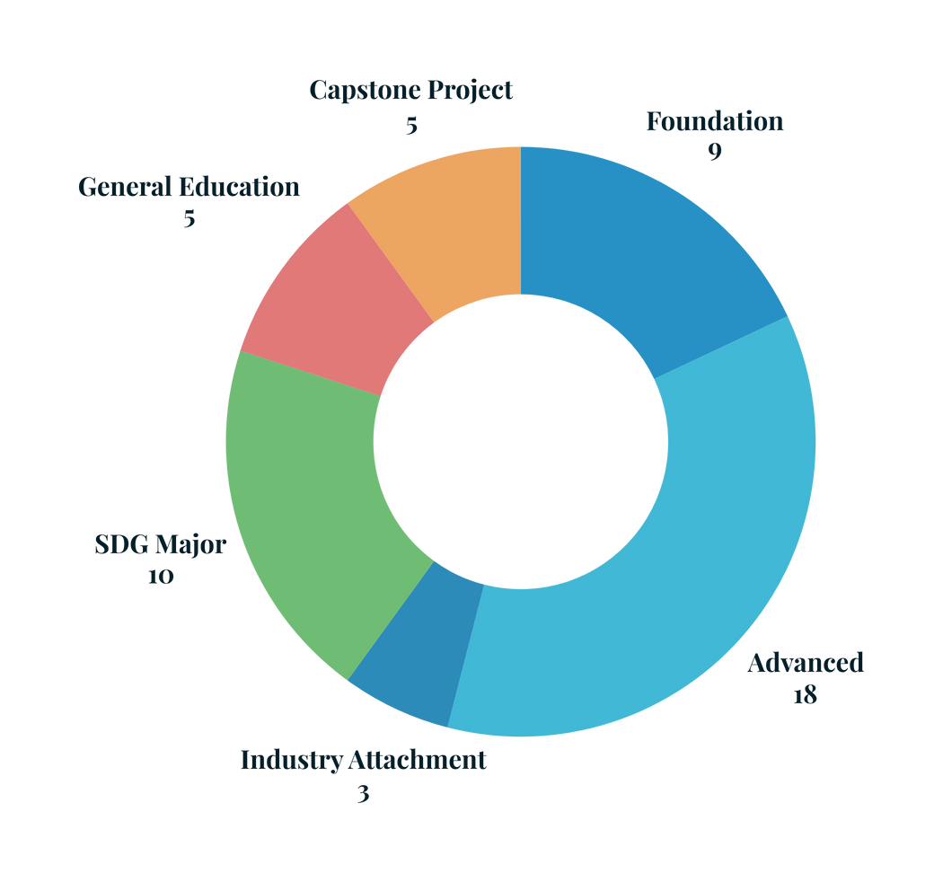




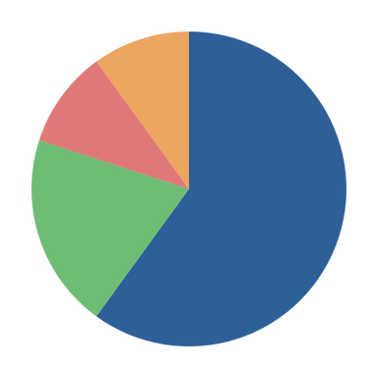
CREDIT STRUCTURE
5 years
50 modules
Discipline
General
18 modules
5 modules
SDG Major
Capstone
10 modules
5 modules
G.L.O.B.E

Slide 14
CURRICULUM
Foundation
SDG Development
Advancement
Specialization
Integration
Year 1
Year 2
Year 3
Year 4
Year 5
Establish foundational knowledge
Introduce interdisciplinary and SDG concepts
Build intermediate understanding in both majors
Focus on core disciplinary skills and SDG-specific foundational knowledge.
Deepen disciplinary expertise
SDG topics become project-based.
Engage in SDG-focused collaborative projects and specialized electives
Consolidate learning in a capstone project
Integrate insights from both majors into a comprehensive, multidisciplinary research or applied project.
G.L.O.B.E

Slide 15


ROUTE
Period | Region | Countries | SDGs Focused | Activities
Sept – Oct | Northern Europe | Norway, Denmark | SDG 7 (Clean Energy), SDG 13 (Climate Action) | Visit renewable energy sites; climate change workshops
Nov – Dec | West Africa | Morocco, Senegal | SDG 6 (Clean Water) SDG 1 (No Poverty) | Field visits to water management projects, poverty alleviation initiatives
Jan – Feb | Southeast Asia | Thailand, Vietnam | SDG 3 (Good Health) SDG 2 (Zero Hunger) | Public health research, sustainable agriculture fieldwork
March – April | South America | Brazil, Colombia | SDG 15 (Life on Land) SDG 12 (Sustainable Cities) | Conservation projects, urban sustainability and waste management initiatives
May | Caribbean and Mexico | Barbados, Mexico | SDG 14 (Life Below Water) SDG 8 (Decent Work) | Marine conservation studies, local economy and sustainable tourism programs
G.L.O.B.E

Slide 16
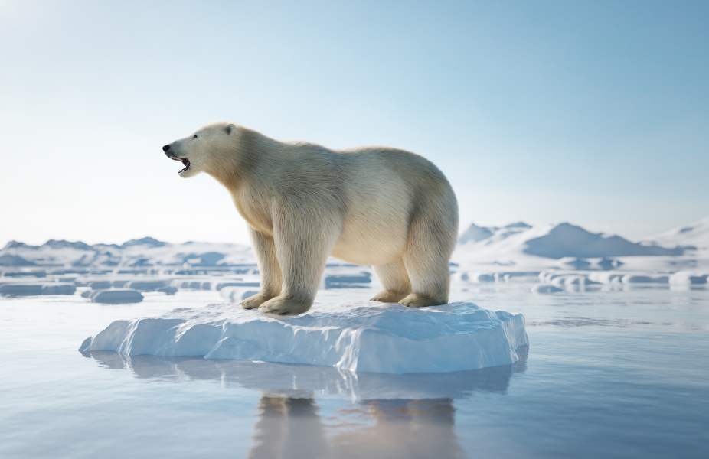
GOAL 13: CLIMATE ACTION
Interdisciplinary Workshops: Students from environmental science, economics, engineering, and political science collaborate on modelling exercises and case studies.
Simulation and Modeling Projects: Students develop feedback models for climate impacts, such as water scarcity or urban pollution.
Field Visits and Sustainability Audits: Students review sites (e.g., renewable energy plants) to assess real-world sustainability practices and issues.
“Systems Thinking for Climate Solutions”
Understand climate issues through a systems perspective, connecting environmental, social, and economic factors.
Apply systems modeling to analyze climate impacts and potential interventions.
Propose innovative, multi-disciplinary solutions to specific climate challenges.
G.L.O.B.E

Slide 17
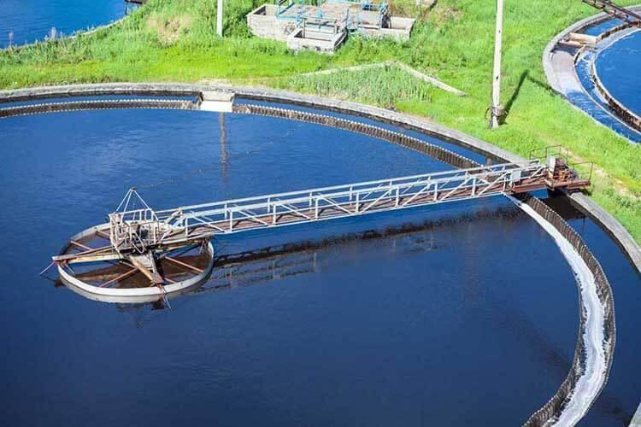
GOAL 06: CLEAN WATER AND SANITATION
Pre-Departure Preparation: Students complete readings on global water scarcity, gaining a rudimentary understanding on the issue
In-Country Experience: Students gain on-site experience, visiting desalination plants and water management projects, as well as traditional water systems. They also interview locals to gain a holistic view of the regions water challenges
Post-Visit Reflection and Project: Students work in groups to present their findings and proposed solutions
“Sustainable Water Solutions in Arid Regions: A Moroccan Case Study”
Cultural Sensitivity and Global Perspective: Through immersive learning and direct engagement with local communities.
Technical Knowledge: Understanding desalination, water management technologies, and sustainable practices.
Problem-Solving and Design Thinking: Applying theoretical knowledge to propose feasible solutions for real-world water challenges.
Interdisciplinary Collaboration: Working in diverse teams and integrating perspectives from environmental science, engineering, policy, and social science.
G.L.O.B.E

Slide 18
ASSESSMENT
Impact Portfolios
Project-Based Assessments
Reflective Analysis
Holistic Capstone Evaluation
Content: Includes projects, case studies, SDG-specific research.
Highlights: Showcases interdisciplinary achievements and real-world SDG contributions.
Personal Reflections: Documents growth, insights, and learning experiences.
Purpose: Demonstrates evolving problem-solving skills and impact.
Outcome: Provides a holistic view of the student’s academic journey within the SDG framework
Collaborative Solution Proposals: Students work in interdisciplinary teams to develop proposals addressing specific SDG issues.
Community-Based Projects: Students partner with NGOs, businesses, or community groups on SDG-aligned initiatives.
Review Process: Faculty and relevant industry or community stakeholders review each project
Reflection: Students consider the potential and limitations of their proposed solutions.
Field Connection: Analyze how their chosen SDG influences their primary area of study.
Ethics and Sustainability: Reflect on how their learning shapes their approach to ethical, inclusive, and sustainable solutions.
Purpose: Promotes critical self-evaluation and heightens awareness of social and ethical implications in their work.
Depth and Rigor: Evaluates thoroughness of analysis.
Relevance and Feasibility: Measures practical applicability of solutions.
Creativity and Originality: Assesses innovation
Social and Environmental Impact: Focuses on tangible contributions and broader implications.
Outcome: Ensures students leave with comprehensive skills and a meaningful contribution to their chosen SDG field.
G.L.O.B.E

Slide 19


INNOVATION
Three Main Points of Innovation:
Incorporation of SDGs into Curriculum
Deviant Interdisciplinary
Semesters at Sea!
Only by opening students’ minds to the world around us can we tackle global problems!
G.L.O.B.E
G.L.O.B.E

Slide 20
SUSTAINABLE DEVELOPMENT GOALS
Incorporation of SDGs into entire curriculum
Through the project-based learning, students will be able to efficiently gather the knowledge to tackle issues surrounding SDGs
SDGs are interdisciplinary in nature: For example, SDG 5 Gender Equality can draw from fields of social sciences, biological sciences and medicine when tackling issues related to women’s reproductive health
G.L.O.B.E

Slide 21
DEVIANT INTERDISCIPLINARITY
Deviant interdisciplinarity allows students to use their first major to address issues of sustainability and also gain a better understanding of each others’ disciplines which poses them in a better position to tackle SDGs
Knowledge brokering (van Weerelt, n.d.) as an example of the inefficiencies of normal disciplinarity
Fuller (2023) envisions a “deviant interdisciplinarity” which views the differences in disciplines as barriers to be torn down in the pursuit of knowledge
SDGs as literal “environmental pressures” which “encourage the creative combination of previously distinct disciplines into an all-purpose technique”
G.L.O.B.E

Slide 22
SEMESTER(S) AT SEA
Previous studies like McCabe (1994) shown how Semester at Sea programmes inculcated a global perspective consisting of
Increased openness to new countries and cultures
Increased awareness of the commonalities of people across different cultures
Increased cross-cultural understanding
A broader viewpoint towards Americanism (which may be applicable to other countries as it stems from the contrast each student had between the US and other countries)
Increased degree of global-centrism as compared to the start of the voyage
G.L.O.B.E

Slide 23
SEMESTER(S) AT SEA
Mbembe (2016): Knowledge as a commodity, where transnational flows of knowledge, flows and education occur
Instead of continuing to focus on nationally-specific education, we will focus on global-centric education which position our students to solve global issues which the SDGs definitely are
Through the multiple years students will spend with their international batchmates, they will be build new “diasporic intellectual networks” through the connections with their peers as well as leverage the resources of “globalized talents” like their professors
G.L.O.B.E

Slide 24
FUTURE WORLD
Our constructed future world is a based off today’s reality:
The presence of knowledge economy and transnational exchanges of labour within higher education
Continued climate crisis leading to more emphasis to be placed on tackling climate change and other issues of sustainability
According to the UN Sustainable Development Goals Report 2024, only 17% of SDGs are on track to being met by the 2030 deadline
As such, we believe in the continued usage of SDGs as a guiding framework even past 2030
G.L.O.B.E

Slide 25
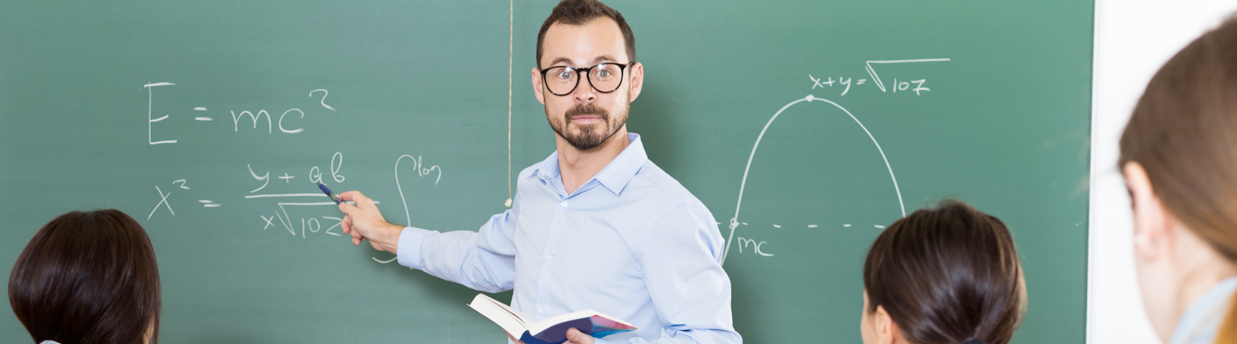

KEY ACTORS / STAKEHOLDERS
Diverse and Hybrid
Committed
Faculty
Students
GLOBE University’s success depends on faculty who bring both depth in their specific disciplines and breadth across fields, embodying a “hybrid” approach to teaching and research.
Visiting scholars who are screened to be committed to GLOBE University’s interdisciplinary vision will supplement students’ technical discipline
Through our assessment criteria, GLOBE University seeks to admit students who are driven by a commitment to impact society positively. The ideal GLOBEIAN is inquisitive, adaptable, and motivated by a desire to engage deeply with complex global challenges.
G.L.O.B.E

Slide 26
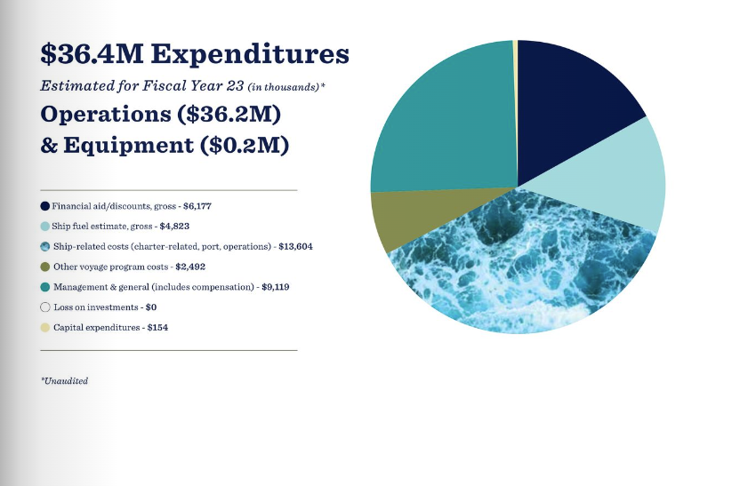
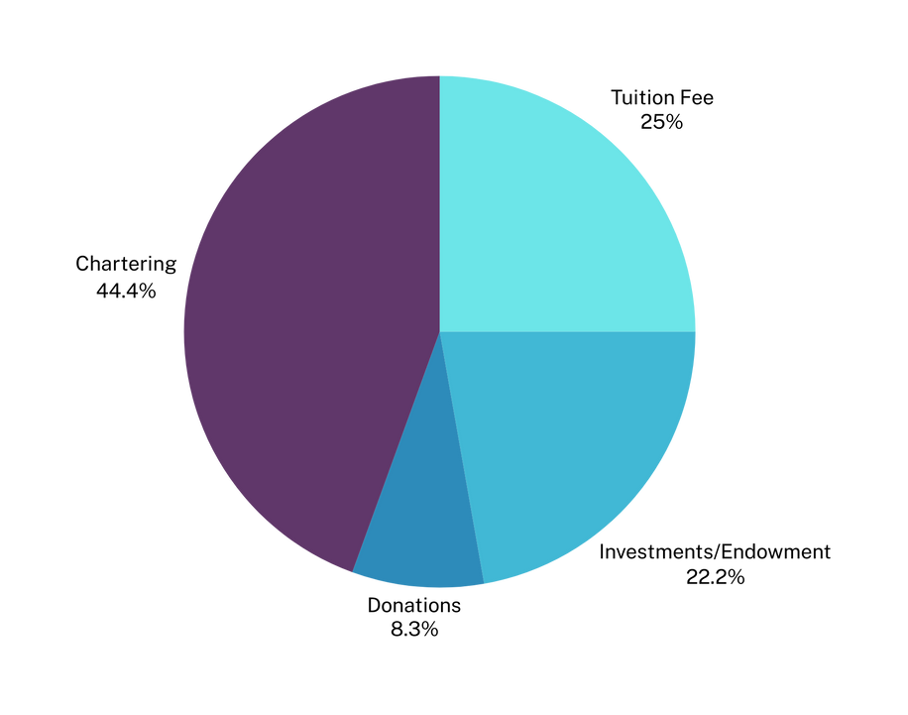
BUDGET
Initial Cost: USD$220 million (as based off MS Roald Amundsen)
Annual Operating Expenditure: USD$36 million (as based off Semester at Sea)
Revenue Streams
G.L.O.B.E

Slide 27


KEY ACTORS / STAKEHOLDERS
Appropriate
Sustainable
Funding Sources
Partners
International organizations such as Joint SDG Fund
Supportive governments
Philanthropic individuals and organizations dedicated to championing environmental causes
Eventually, alumni
Collaborations with NGOs and organisations will enable service learning during fieldwork projects where students work on interdisciplinary projects
G.L.O.B.E

Slide 28
VALUE
GLOBE University is a global institution that transforms higher education by embedding SDGs, fostering diverse talent through needs-blind admissions, and pioneering deviant interdisciplinarity for innovative problem-solving.
Through SDG-focused industry attachments and a sustainable campus model, it leads in delivering impactful, globally relevant education.
G.L.O.B.E

Slide 29
Thank you!
G.L.O.B.E

Slide 30
REFERENCES
Fuller, S. (2023). Deviant Interdisciplinarity as Philosophy Humboldt-Style. In Back to the University's Future: The Second Coming of Humboldt (p. 15-38). Cham: Springer International Publishing.
[Video] TEDx talk by Prof. Helfand. https://www.youtube.com/watch?v=DZQe73IXZtU
Mbembe, A. J. (2016). Decolonizing the university: New directions. Arts and Humanities in Higher Education, 15(1), 29-45. https://doi-org.libproxy1.nus.edu.sg/10.1177/1474022215618513
Skyrme, J. (2021, Apr 21) Universities Should Focus on What They’re Good For, Not Good At. Times Higher Education. https://www.timeshighereducation.com/opinion/universities-should-focus-what- theyre-good- not-good
Semester at Sea. (2023). Annual Report: Fiscal Year June 1, 2022 - May 31, 2023. https://www.semesteratsea.org/alumni/resources/
McCabe, L. T. (1994). The Development of a Global Perspective During Participation in Semester at Sea: a comparative global education program. Educational Review, 46(3), 275–286. https://doi.org/10.1080/0013191940460305
van Weerelt, P. (n.d.) Is knowledge brokering the missing link between science and changing behaviours for sustainable development and climate action? UN: SDG Learn. https://www.unsdglearn.org/podcast/is-knowledge-brokering-the-missing-link-between-science-and-changing-behaviours-for-sustainable-development-and-climate-action/
United Nations Department of Economic and Social Affairs. (2009). The Sustainable Development Goals Report 2024. https://unstats.un.org/sdgs/report/2024/The-Sustainable-Development-Goals-Report-2024.pdf

Slide 31
AI-Use Acknowledgement
The GLOBE University logo and campus images on slides 9-11 were created with the aid of AI-related tools

